Slide 1

Polymorphic Assignment
&
Polymorphism
Notes:
This presentation explains two object oriented programming concepts namely polymorphic assignment and polymorphism. These concepts are demonstrated in chapter 6 in the second edition of the prescribed textbook.

Slide 2
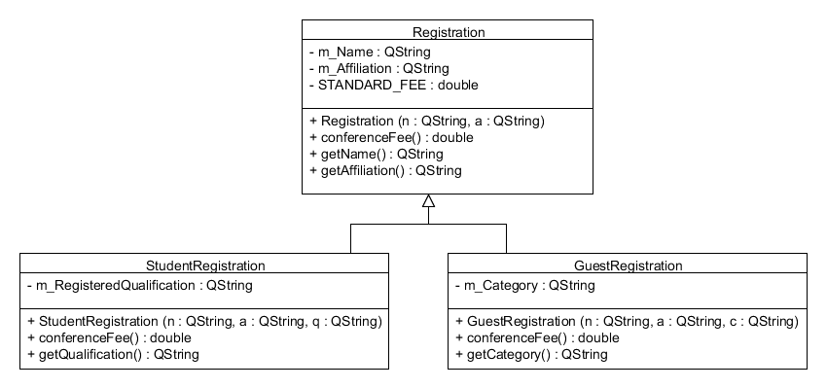



Registration class hierarchy
Notes:
Polymorphic assignment and polymorphism can only be explained within the context of a class hierarchy. So, let’s consider a class hierarchy that represents different types of registrations to attend a conference.
In this design, we have three classes, Registration, which is the super class and two subclasses StudentRegistration and GuestRegistration.
The class Registration represents a regular or normal conference registration and the const data member STANDARD_FEE represents the standard conference fee. StudentRegistration is only for students attending the conference and they qualify for a 50% discount on the standard conference fee.
The registration of an invited guest to the conference is represented using GuestRegistration and such attendees only pay 10% of the standard registration fee.
Let us now look at the classes in detail:
In Registration m_Name and m_Affiliation represent the name and affiliation of the attendee. As mentioned previously, standard fee is a const data member to represent the standard fee. This class has a two-argument constructor to initialize m_Name and m_Affiliation , a function conferenceFee() that simply returns the STANDARD_FEE and two getters getName() and getAffiliation() that return the values stored in m_Name and m_Affiliation respectively.
StudentRegistration has an additional data member to represent the qualification for which the student is registered. It has a three-argument constructor to initialize m_Name, m_Affiliation and m_RegisteredQualification, the function conferenceFee() which returns a 50% discounted conference fee and a getter to return the string stored in m_RegisteredQualification.
GuestRegistration has a data member m_Category to represent the type of invited guest such as guest speaker, exhibitor, etc. It also has a 3-argument constructor to initialize m_Name, m_Affiliation and m_Category. The function conferenceFee() calculates and returns 10% of the STANDARD_FEE and getCategory() returns the value stored in m_Category.

Slide 3
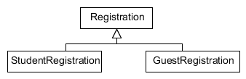

Valid Assignment Statements
Registration *r1 = new Registration("G Smit", "UP");
StudentRegistration *r2 = new StudentRegistration("T Moyo", "UNISA", "MSc Computing");
GuestRegistration *r3 = new GuestRegistration("K John", "UCT", "Keynote Speaker");
Notes:
Based on the given class hierarchy the following assignment statements are valid because the types of the pointer variables on the left hand side are the same as the type of the objects created on the right hand side of these assignment statements.

Slide 4
Polymorphic Assignment
Polymorphic assignment allows a pointer of type superclass to point to objects of its concrete (not abstract) subclasses.
Notes:
Now we look at polymorphic assignment. Polymorphic assignment allows a pointer of type superclass to point to objects of its concrete subclasses. Remember the rule that only concrete classes can be instantiated.

Slide 5
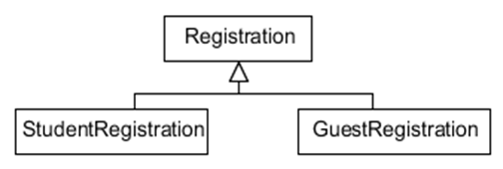

Polymorphic Assignment: Examples
Registration *r3 = new StudentRegistration("L Kgomotso", "TUT", "B-Tech");
Registration *r4 = new GuestRegistration("M Cloete", "Wits", "Presentation Judge");
Notes:
Let us look at some examples of polymorphic assignments: In the first one pointer r3 is of type Registration, which points to an object of StudentRegistration, which is a subclass of Registration. This assignment is valid because the type of the pointer on the left hand side is the superclass and the right hand side contains an instantiation of its concrete subclass.
Similarly, the second assignment is also valid because the type on the left hand side is again the superclass, which is made to point to an instance of its subclass.

Slide 6
To reiterate
All these assignment statements are correct for the given class hierarchy:
Registration *r1 = new Registration("G Smit", "UP");
StudentRegistration *r2 = new StudentRegistration("T Moyo", "UNISA", "MSc Computing");
GuestRegistration *r3 = new GuestRegistration("K John", "UCT", "Keynote Speaker");
Registration *r3 = new StudentRegistration("L Kgomotso", "TUT", "B-Tech");
Registration *r4 = new GuestRegistration("M Cloete", "Wits", "Presentation Judge");
Notes:
To repeat all these 5 assignment statements are correct. Note that the last two statements demonstrate polymorphic assignment.

Slide 7
Polymorphic Assignment: Another Example
void doSomething(Registration* r){
//do something with the object pointed to by r
}
doSomething(new Registration("G Smit", "UP"));
doSomething(new StudentRegistration("T Moyo", "UNISA", "MSc Computing"));
doSomething(new GuestRegistration("K John", "UCT", "Keynote Speaker"));
Notes:
Here is another example of polymorphic assignment which we often use.
Here the input parameter of the function doSomething() is a pointer of type Registration. You can invoke this function by passing a Registration or a StudentRegistration or a GuestRegistration object.

Slide 8

Polymorphism
Polymorphism can only be utilized when a virtual function of the superclass is overridden in its subclass(es).
Notes:
Now that you know what polymorphic assignment is let us explore polymorphism. Polymorphism can only be utilized when a virtual function of the superclass is overridden in its subclass(es).
Let’s look at the Registration class hierarchy to see which function can be overridden in StudentRegistration and GuestRegistration. You will see that the function conferenceFee() is defined in all three classes, which means the function conferenceFee() is meant to be overridden in StudentRegistration and GuestRegistration.

Slide 9
Define and Implement: calculateFee()
Class | Definition (in .h file) | Implementation (in .cpp file)
Registration | virtual double calculateFee() const; | double Registration:: calculateFee() const { return STANDARD_FEE;}
StudentRegistration | double calculateFee() const; | double StudentRegistration:: calculateFee() const { return Registration::calculateFee()* 50/100;}
GuestRegistration | double calculateFee() const; | double GuestRegistration:: calculateFee() const { return Registration::calculateFee()* 10/100;}
Notes:
Let us see how the function calculateFee() is defined and implemented in all three classes to utilize polymorphism.
Firstly in Registration, the function calculateFee() is defined as a virtual function. The keyword virtual is essential in switching on polymorphism. The function is const because this function does not change the data members of Registration. In the implementation it simply returns the STANDARD_FEE.
StudentRegistration overrides calculateFee() in Registration. The definition of calculateFee() is exactly the same as in Registration without virtual. In the implementation of this function, we use partial overriding to get the STANDARD_FEE and it returns 50% of the STANDARD_FEE.
GuestRegistration also overrides calculateFee() in Registration. The definition of calculateFee() is exactly the same as in Registration without virtual. In the implementation of this function, we use partial overriding to get the STANDARD_FEE and it returns 10% of the STANDARD_FEE.

Slide 10
Polymorphism
A function invocation on a pointer of type superclass can give different results based on the object pointed to by the pointer
The different results is due to the execution of different overridden functions in the subclasses
Notes:
Polymorphism is when a function invocation on a pointer of type superclass can give different results based on the object pointed to by the pointer. You get different results because different overridden functions are executed depending on the object pointed to by the pointer.

Slide 11
Polymorphism: Example
Assume that the data member STANDARD_FEE in Registration is initialized to 1000.00.
void displayConferenceFee(Registration* r){
cout << r->calculateFee();
}
displayConferenceFee(new StudentRegistration("T Moyo", "UNISA", "MSc Computing"));
Output: 500.00
displayConferenceFee(new GuestRegistration("K John", "UCT", "Keynote Speaker"));
Output: 100.00
displayConferenceFee(new Registration("G Smit", "UP"));
Output: 1000.00
Notes:
Assume that the data member STANDARD_FEE in Registration is initialized to 1000.00.
Consider this function displayConferenceFee() which takes a Registration pointer as the input parameter and simply invokes the function calculateFee() on the pointer.
First we invoke displayConferenceFee() by passing a StudentRegistration object. For this specific invocation, the output displayed will be 500 which is 50% of 1000.00. The reason is that the pointer r now points to a StudentRegistration object and hence it invokes the calculateFee() in StudentRegistration.
Next we invoke displayConferenceFee() by passing a GuestRegistration object. For this specific invocation, the output displayed will be 100 which is 10% of 1000.00. Here r points to a GuestRegistration object and hence it invokes the calculateFee() in GuestRegistration.
If we invoke displayConferenceFee() by passing a Registration object the output displayed will be 1000 which is the STANDARD_FEE. Here the calculateFee() in Registration is invoked.
As you can see the statement r->calculateFee() results in different function executions depending on what r is pointing to. The decision about which calculateFee() to be executed is resolved at run-time; this is called dynamic binding.

Slide 12
Summary
Pointer of type superclass
void displayConferenceFee(Registration* r){
cout << r->calculateFee();
}
virtual in Registration
It is overridden in StudentRegistration and GuestRegistration
Notes:
We managed to utilize polymorphism in this function because
calculateFee() is defined virtual in Registration
calculateFee() is overridden in all the subclasses of Registration
The input parameter of this function is of type superclass

Slide 13
Without virtual
Class | Definition (in .h file) | Implementation (in .cpp file)
Registration | virtual double calculateFee() const; | double Registration:: calculateFee() const { return STANDARD_FEE;}
StudentRegistration | double calculateFee() const; | double StudentRegistration:: calculateFee() const { return Registration::calculateFee()* 50/100;}
GuestRegistration | double calculateFee() const; | double GuestRegistration:: calculateFee() const { return Registration::calculateFee()* 10/100;}
Notes:
What happens if we delete virtual from the calculateFee() definition in Registration?

Slide 14
Without virtual
Assume that the data member STANDARD_FEE in Registration is initialized to 1000.00.
void displayConferenceFee(Registration* r){
cout << r->calculateFee();
}
displayConferenceFee(new StudentRegistration("T Moyo", "UNISA", "MSc Computing"));
Output: 1000.00
displayConferenceFee(new GuestRegistration("K John", "UCT", "Keynote Speaker"));
Output: 1000.00
displayConferenceFee(new Registration("G Smit", "UP"));
Output: 1000.00
Notes:
Without the virtual keyword in the calculateFee() definition in Registration, the function displayConference() will always display 1000.00 assuming that the STANDARD_FEE in Registration is 1000.00 because the statement r->calculateFee() will only execute the calculateFee() in Registration because r is a pointer of type Registration.

Slide 15
Conclusion
Polymorphism and polymorphic assignment are two great features of object oriented (OO) programming.
Use them well in your OO programs!
Notes:
Polymorphism and polymorphic assignment are two useful features of object oriented (OO) programming.
Use them well in your OO programs!

